Slide 1
Visual Question Answering
Reno Kriz
Stat 991

Slide 2
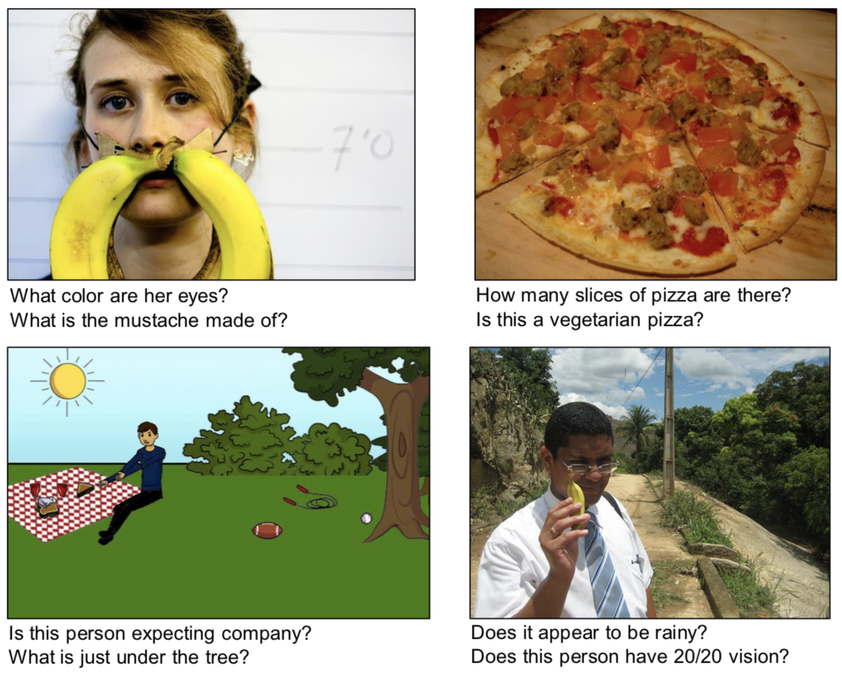
What Is Visual Question Answering (VQA)?
VQA is the task of answering questions about images.
Seminal VQA work used smaller datasets that were limited in scope (Malinowski and Fritz, 2014).
Most recent work has focused on free-form and open-ended questions (Agrawal et al., 2015).
Examples of images and questions from the VQA dataset (Agrawal et al., 2015)

Slide 3
Why VQA?
Multi-modal task that requires understanding a variety of tasks.
Computer Vision
Natural Language Processing (NLP)
Common-sense reasoning
Easy-to-define automatic evaluation metric, while still being a generation task
This is important, many generative tasks in NLP don’t have this!

Slide 4
Background: Image Classification
Prior to 2012, image classification was mainly done on relatively small datasets of images, due to computing limitations (images have many dimensions!)
Krizhevsky et al. (2012) was the first to successfully train a neural network on a much larger scale for image classification
This paper used a Convolution Neural Network (CNN).
To train, the authors optimized by making use of several convolution learned layers first to make the number of parameters tractable to learn.

Slide 5
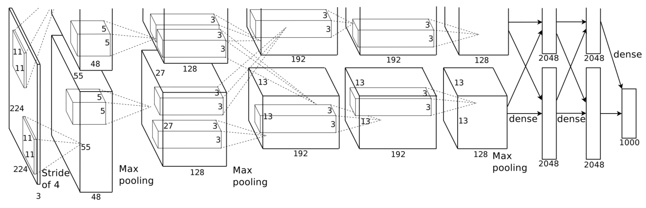
Background: Image Classification
Architecture of the CNN from Krizhesky et al. (2012), which consists of 5 convolutional layers followed by 3 fully-connected layers.

Slide 6
Background: Sequence-to-Sequence Models (Seq2Seq)
Many tasks in NLP can be formulated as mapping one sequence to another.
Machine Translation, Dialogue Systems, Part-of-Speech tagging, Text Simplification, etc.
We usually don’t know the length of either the input sequence, the output sequence, or both!

Slide 7
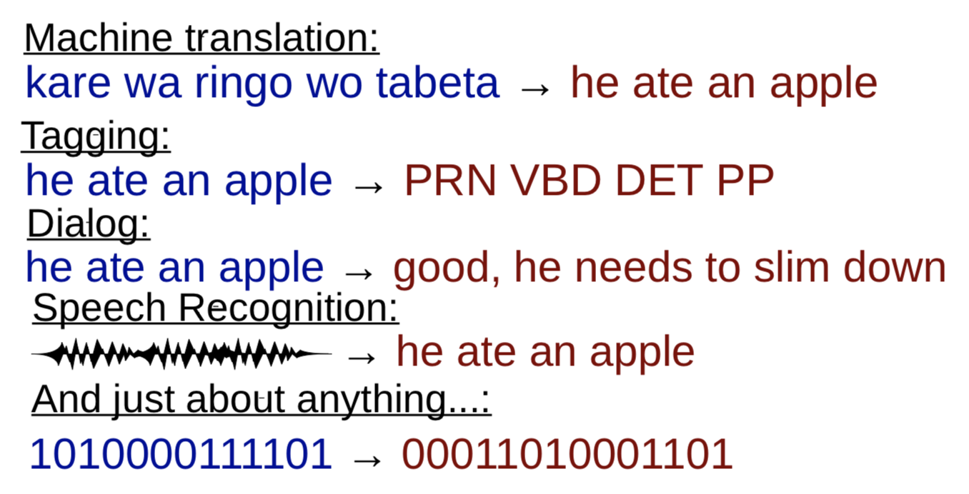
Background: Seq2Seq Models
Examples of Seq2Seq tasks taken from Neubig (2017).

Slide 8
Background: Seq2Seq Models
Slides shamelessly borrowed from John Hewitt. (https://nlp.stanford.edu/~johnhew/public/14-seq2seq.pdf)
The memory vector, or “state” .
General Idea: build a representation of the input:
The method of building the representation is called an Encoder and is frequently an RNN.
The “word vector” representation of the word.
Only
use
neural
nets
The RNN function, which combines the word vector and the previous state to create a new state.
Each memory vector in the encoder attempts to represent the sentence so far, but mostly represents the word most recently input.

Slide 9
BackGround: Seq2Seq Models
Slides shamelessly borrowed from John Hewitt. (https://nlp.stanford.edu/~johnhew/public/14-seq2seq.pdf)
The RNN function takes the current RNN state and a word vector and produces a subsequent RNN state that “encodes” the sentence so far.
RNN
function
:=
+
+
1
2
3
Learned weights representing how to combine past information (the RNN memory) and current information (the new word vector.)

Slide 10
BackGround: Seq2Seq Models
Slides shamelessly borrowed from John Hewitt. (https://nlp.stanford.edu/~johnhew/public/14-seq2seq.pdf)
How do RNN’s produce probability distributions over a vocabulary?
Only
use
neural
softmax(
) =
4
A probability distribution over the vocab, constructed from the RNN memory and 1 last transformation (in green.) The softmax function turns “scores” into a probability distribution.

Slide 11
Background: Seq2Seq Models
Slides shamelessly borrowed from John Hewitt. (https://nlp.stanford.edu/~johnhew/public/14-seq2seq.pdf)
General idea: generate the output one token at a time
The model that takes the encoded representation and generates the output is called the Decoder, and is also generally an RNN.
Only
use
neural
nets
Jiri

Slide 12
Background: Seq2Seq Models
Slides shamelessly borrowed from John Hewitt. (https://nlp.stanford.edu/~johnhew/public/14-seq2seq.pdf)
General idea: generate the output one token at a time
The model that takes the encoded representation and generates the output is called the Decoder, and is also generally an RNN.
Only
use
neural
nets
Jiri
naanị

Slide 13
Background: Seq2Seq Models
Slides shamelessly borrowed from John Hewitt. (https://nlp.stanford.edu/~johnhew/public/14-seq2seq.pdf)
General idea: generate the output one token at a time
The model that takes the encoded representation and generates the output is called the Decoder, and is also generally an RNN.
Only
use
neural
nets
Jiri
naanị
netwọk

Slide 14
Background: Seq2Seq Models
Slides shamelessly borrowed from John Hewitt. (https://nlp.stanford.edu/~johnhew/public/14-seq2seq.pdf)
General idea: generate the output one token at a time
The model that takes the encoded representation and generates the output is called the Decoder, and is also generally an RNN.
Only
use
neural
nets
Jiri
naanị
netwọk
nụ

Slide 15
Background: Seq2Seq Models
Slides shamelessly borrowed from John Hewitt. (https://nlp.stanford.edu/~johnhew/public/14-seq2seq.pdf)
General idea: generate the output one token at a time
The model that takes the encoded representation and generates the output is called the Decoder, and is also generally an RNN.
Only
use
neural
nets
Decoder (2seq)
Encoder (seq)
Jiri
naanị
netwọk
nụ

Slide 16
Background: Seq2Seq Models
Slides shamelessly borrowed from John Hewitt. (https://nlp.stanford.edu/~johnhew/public/14-seq2seq.pdf)
In practice, training for a single sentence is done by “forcing” the decoder to generate gold sequences, and penalizing it for assigning the sequence a low probability. Losses for each token in the sequence are summed. Then, the summed loss is used to take a step in the right direction in all model parameters (including word embeddings!) (stochastic gradient descent.)
neural
nets
P(Jiri|encoder) = .7
P(naanị|encoder) = .15
P(netwọk|encoder) = .1
P(nụ|encoder) = .5

Slide 17
Background: Seq2Seq Models
Slides shamelessly borrowed from John Hewitt. (https://nlp.stanford.edu/~johnhew/public/14-seq2seq.pdf)
In practice, training for a single sentence is done by “forcing” the decoder to generate gold sequences, and penalizing it for assigning the sequence a low probability. Losses for each token in the sequence are summed. Then, the summed loss is used to take a step in the right direction in all model parameters (including word embeddings!) (stochastic gradient descent.)
neural
nets
.7
Jiri
nụ
naanị
netwọk
P(Jiri|encoder) = .7
P(naanị|encoder) = .15
P(netwọk|encoder) = .1
P(nụ|encoder) = .5

Slide 18
Back to VQA!
From Malinkowski et al. (2015)
https://arxiv.org/pdf/1505.01121.pdf
We can combine CNN for image representation and Seq2Seq conditional languages for VQA.
Malinkowski et al. (2015) proposes an end-to-end formulation (Neural-Image-QA), which trains all parts jointly.
The image is first analyzed via a CNN.
The image and question are then fed into an Long Short Term Memory Network (LSTM).
The answer is then generated via a decoder one token at a time.

Slide 19
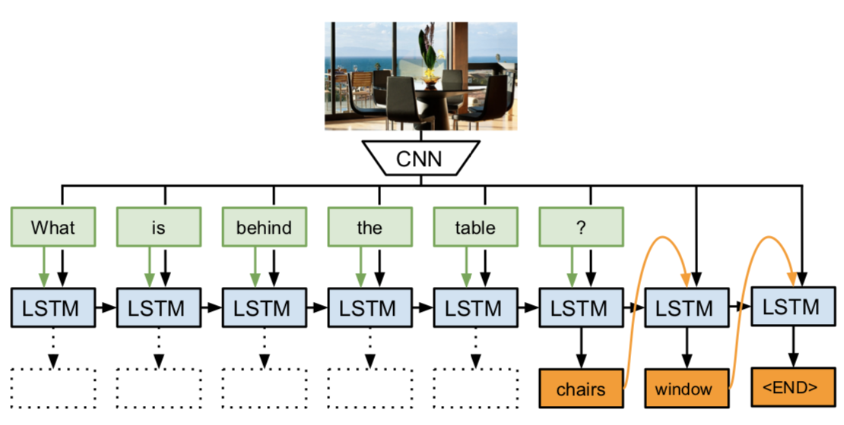
Neural-Image-QA: Approach
From Malinkowski et al. (2015)
https://arxiv.org/pdf/1505.01121.pdf
VQA Architecture of Neural-Image-QA

Slide 20
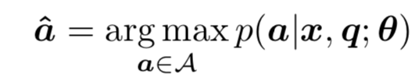
Neural-Image-QA: Approach
From Malinkowski et al. (2015)
https://arxiv.org/pdf/1505.01121.pdf
Problem formulation: Given an image x and a question q, predict an answer a according to a parametric probability measure:
θ represent a vector of all parameters to learn and A is a set of all answers.

Slide 21
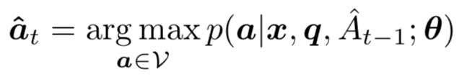
Neural-Image-QA: Approach
From Malinkowski et al. (2015)
https://arxiv.org/pdf/1505.01121.pdf
We can break down this problem into generating a set of answer words
a_{q,t} = {a₁,a₂ ,...,a_{N(q, x)}}
a_{t} are words from a finite vocabulary V’.
When generating, we instead predict words from V = V’ ∪ {$}, where $ is a token representing the end-of-sequence.
We can formulate the problem recursively as follows:

Slide 22
Neural-Image-QA: Implementation
From Malinkowski et al. (2015)
https://arxiv.org/pdf/1505.01121.pdf
The CNN was first pretrained on the ImageNet dataset.
To finetune for this task, the last layer of the CNN was randomly initialized and then trained jointly with the LSTM network.
Lots of hyperparameters to tune (learning rate, dropout, number of hidden units, number of layers, etc.)
This tuning is very important for many NLP and vision tasks!

Slide 23
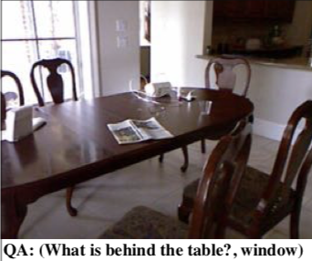
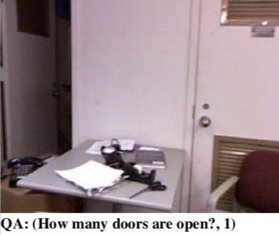
Neural-Image-QA: Experimental Setup
From Malinkowski et al. (2015)
https://arxiv.org/pdf/1505.01121.pdf
This work uses the DAtaset for QUestion Answering on Real-world images (DAQUAR) dataset.
This contains12,468 human question-answer pairs on images of indoor scenes (Malinkowski and Fritz, 2014).

Slide 24
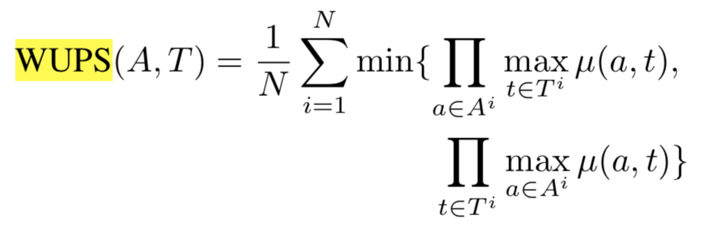
Neural-Image-QA: Evaluation Metrics
From Malinkowski et al. (2015)
https://arxiv.org/pdf/1505.01121.pdf
Along with standard accuracy, this paper uses WUPS, a generalization of accuracy that accounts for word-level ambiguities in the answer words.
Intuition: ‘carton’ and ‘box’ are similar words, and the model should not be penalized harshly for outputting one or the other.
Here, A^{i} and T^{i} represent the i-th generated answer and ground truth, respectively.
μ represents a thresholded similarity metric (lower threshold means more forgiving)
This work uses thresholds of 0.9 and 0.

Slide 25
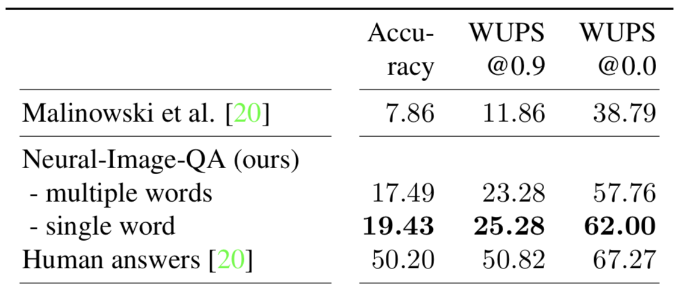
Neural-Image-QA: Results
From Malinkowski et al. (2015)
https://arxiv.org/pdf/1505.01121.pdf
Results on DAQUAR, all classes, single reference.

Slide 26
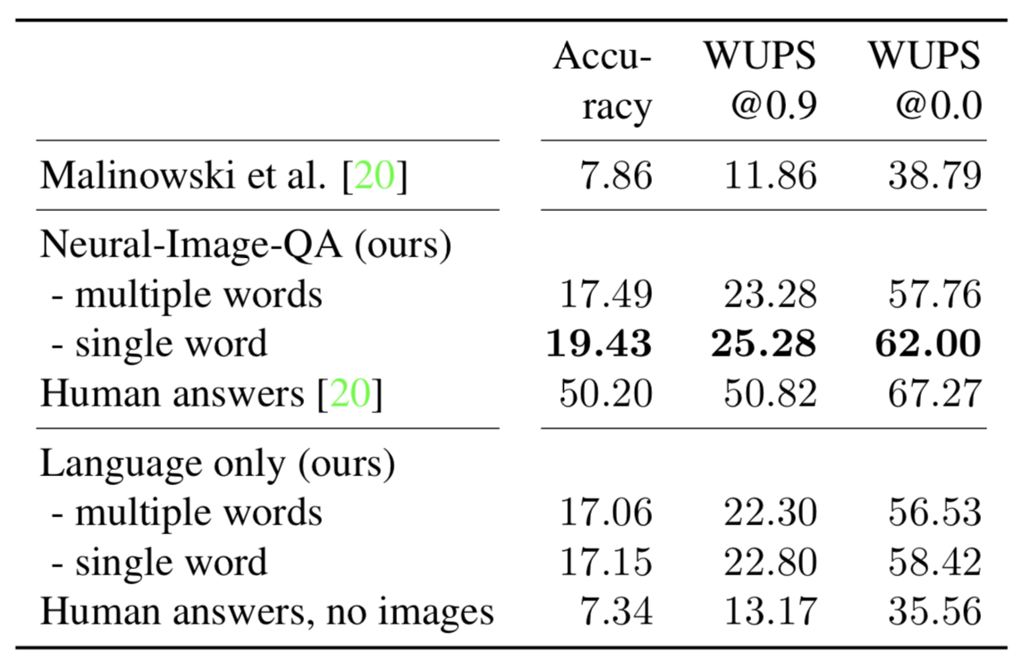
Neural-Image-QA: Results
From Malinkowski et al. (2015)
https://arxiv.org/pdf/1505.01121.pdf
Results on DAQUAR, all classes, single reference.

Slide 27
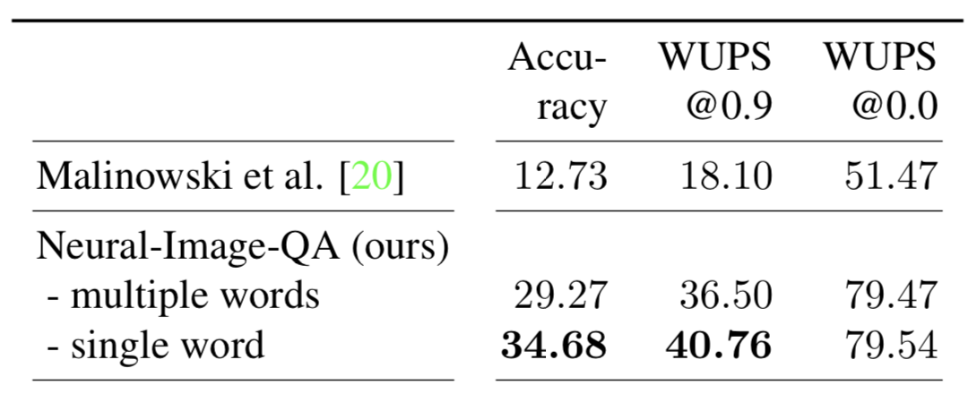
Neural-Image-QA: Results
From Malinkowski et al. (2015)
https://arxiv.org/pdf/1505.01121.pdf
Results on a reduced set of 37 object classes and 25 test images with 297 question-answer pairs.

Slide 28
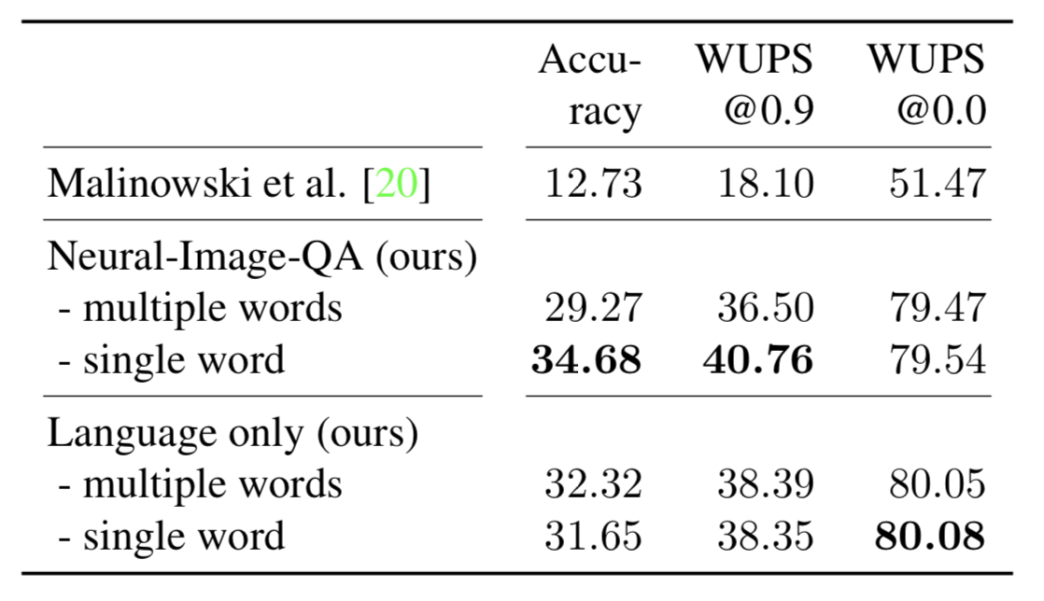
Neural-Image-QA: Results
From Malinkowski et al. (2015)
https://arxiv.org/pdf/1505.01121.pdf
Results on a reduced set of 37 object classes and 25 test images with 297 question-answer pairs.

Slide 29
Why do Images not Matter?
Many early VQA datasets were extremely biased.
41% of questions starting with “What sport is…” could be answered with “tennis”.
There is a a particular ‘visual priming bias’ in the VQA dataset – specifically, subjects saw an image while asking questions about it (Zhang et al., 2016).
For questions starting with “Do you see a…”, answering “yes” results in an accuracy of 87%!

Slide 30
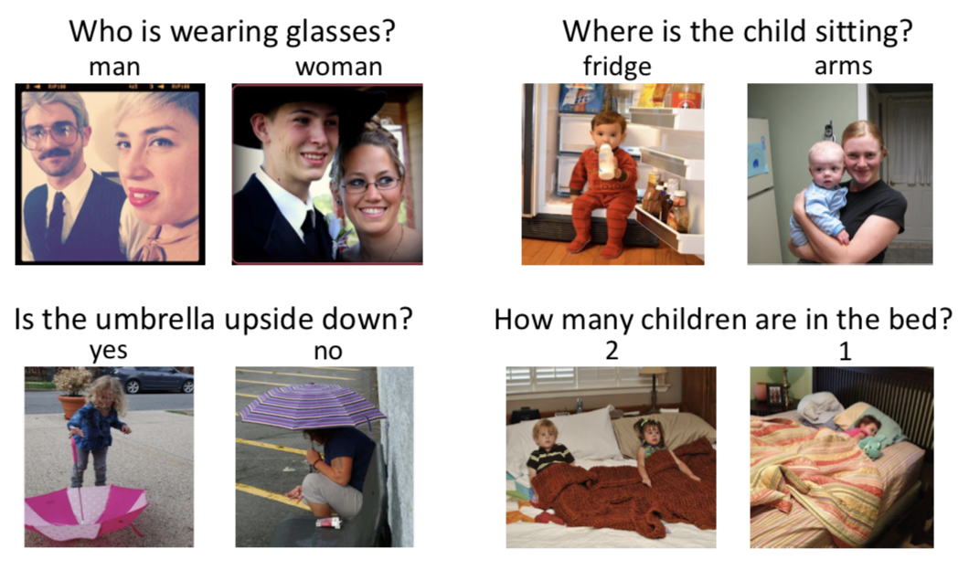
One Solution: Balance The Dataset
Starting with the VQA dataset, Goyal et al. (2016) collects a second image for each question.
These images result in two different answers to the question.
Sample images from a balanced VQA dataset (Goyal et al., 2016)

Slide 31
Where to Go from Here?
The original CNNs and Seq2Seq models have been vastly improved.
Attention-based and transformer networks have been introduced, which greatly improve scalability and performance.
We can also incorporate Reinforcement Learning into these frameworks!

Slide 32
References
Sutskever, Ilya, Oriol Vinyals and Quoc V. Le. “Sequence to Sequence Learning with Neural Networks.” NIPS (2014).
Antol, Stanislaw, Aishwarya Agrawal, Jiasen Lu, Margaret Mitchell, Dhruv Batra, C. Lawrence Zitnick and Devi Parikh. “VQA: Visual Question Answering.” 2015 IEEE International Conference on Computer Vision (ICCV) (2015): 2425-2433.
Goyal, Yash, Tejas Khot, Douglas Summers-Stay, Dhruv Batra and Devi Parikh. “Making the V in VQA Matter: Elevating the Role of Image Understanding in Visual Question Answering.” 2017 IEEE Conference on Computer Vision and Pattern Recognition (CVPR) (2017): 6325-6334.
Krizhevsky, Alex, Ilya Sutskever and Geoffrey E. Hinton. “ImageNet Classification with Deep Convolutional Neural Networks.” Commun. ACM 60 (2012): 84-90.
Malinowski, Mateusz and Mario Fritz. “A Multi-World Approach to Question Answering about Real-World Scenes based on Uncertain Input.” NIPS (2014).
Malinowski, Mateusz, Marcus Rohrbach and Mario Fritz. “Ask Your Neurons: A Deep Learning Approach to Visual Question Answering.” International Journal of Computer Vision 125 (2017): 110-135.
Neubig, Graham. “Neural Machine Translation and Sequence-to-sequence Models: A Tutorial.” CoRR abs/1703.01619 (2017).

